Slide 1
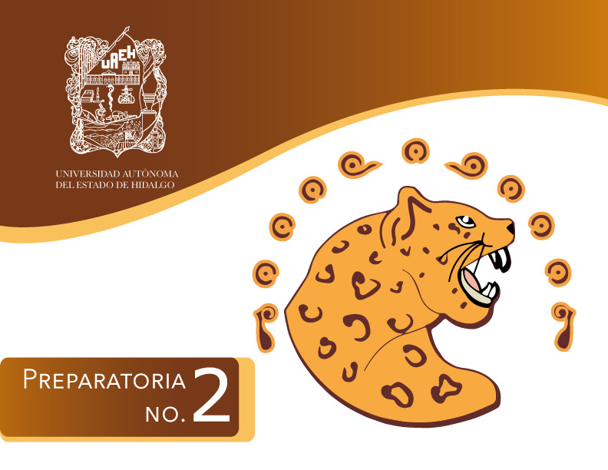
Área Académica:
INGLES Tema:
RELATIVE PRONOUNS Profesor: MARCELA CAMACHO IBERRI Periodo: ENE-JUN 2015

Slide 2

Tema: RELATIVE PRONOUNS
Abstract:
A relative pronoun is a pronoun that introduces a relative clause. It is called a "relative" pronoun because it "relates" to the word that its relative clause modifies
Realtive pronouns are used to give extra information
Keywords: WHO, WHICH, THAT

Slide 3
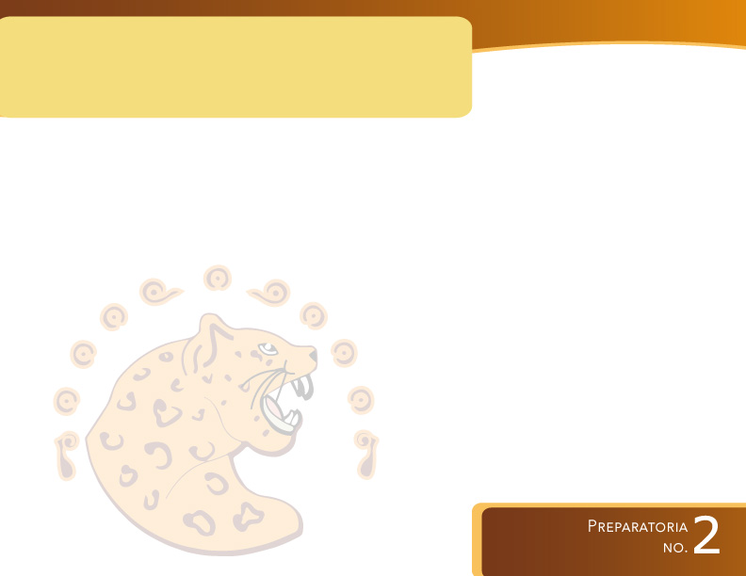
COMPETENCIA(S) DE LA UNIDAD:
Analiza, identifica e interpreta la idea general de mensajes alternos de forma escrita y verbal para hacer énfasis en los resultados de las acciones y no en quién las realiza recurriendo a conocimientos previos en un contexto cultural.
Produce textos y/o composiciones coherentes y creativas, con base en el uso normativo de la lengua, considerando la intención y situación comunicativa

Slide 4
OBJETIVO
Identifica y comprende las ideas principales de un texto relacionado a la descripción de personas, objetos y lugares.
Identifica el uso de los pronombres relativos .
who
which
that

Slide 5
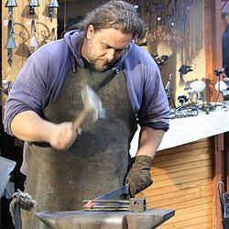
VOCABULARY
Blacksmith is a person who creates objects from wrought iron or steel by forging the metal.

Slide 6
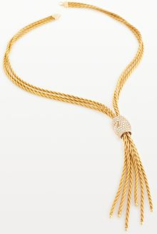
A goldsmith is a metalworker who specializes in working with gold and other precious metals.

Slide 7
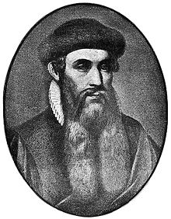
Do you know who was gutenbert?
Gutenberg was German blacksmith, goldsmith, printer, and publisher who introduced printing to Europe. His invention started the Printing Revolution and is widely regarded as the most important event of the modern period.

Slide 8
Gutenberg was born in the German city of Mainz, the youngest son of the upper-class merchant Friele Gensfleisch zur Laden, and his second wife, Else Wyrich, who was the daughter of a shopkeeper.

Slide 9
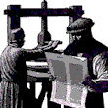

Slide 10
EXERCISES
WRITE THE CORRECT RELATIVE PRONOUN IN THE MISSING SPACE

Slide 11
Did you ever wonder what was the first mass produced book?
The first mass produced printed book was the Bible, which version was based on the Latin edition from about 380 AD.. The Bible was printed at Mainz, Germany by Johannes Gutenberg from 1452 -1455.

Slide 12
LET´S TALK ABOUT INVENTIONS
The telephone is an instrument ____________ converts voice and sound signals into electrical impulses for transmission by wire to a different location, where another telephone receives the electrical impulses and turns them back into recognizable sounds

Slide 13
Thomas Savery was an English military engineer and inventor _____________ in 1698, patented the first crude steam engine.
The first still images transmitted over a wire system were done on the Pantelegraph. The Pantelegraph was invented in 1862 Abbe Giovanna Caselli. Today, over 48 million televisions ____________ are sold per year in North America alone. Television has and will continue to play a vital role in the socialization of the 21st century.

Slide 14
It is said ancient Indians were the first to use pens made of bird feathers and bamboo sticks. Reed pens are made from bamboo sticks ________ are still used today by students in Pakistan.

Slide 15
Now write about another inventions
Battery:
Invent- Alessandro Volta /1792./It
alian physicist
Bicycle
Invent Karl von Drais / 1818/ German Baron
CD
invent /James Russell/1965/a disc /could be read with a laser

Slide 16
BIBLIOGRAPHY
WIKIPEDIA: http://es.wikipedia.org/wiki/Johannes_Gutenberg. Recuperado en 2015

